Slide 1
Deep Learning in ML

Slide 2
Today’s Topics
Deep Learning : History
Why it became a hype after so long?
Artificial Neural Network : Perceptron
Neuron
Two Layered ANN
Back Propagation
Big Data Fundamentals

Slide 3
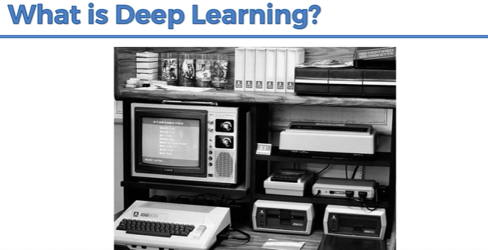

Slide 4
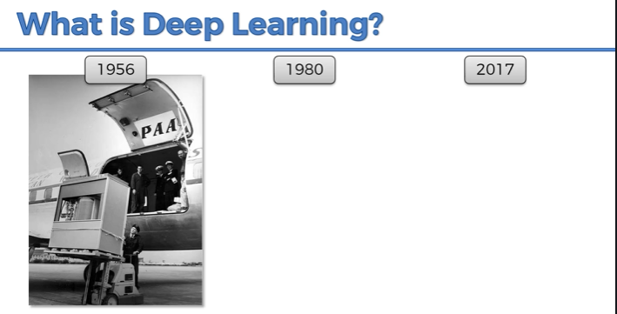
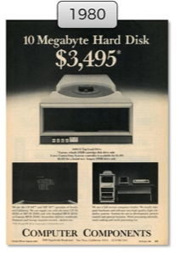
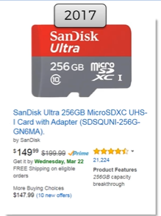


Slide 5
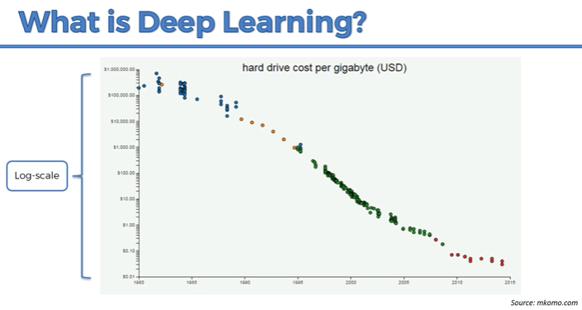

Slide 6
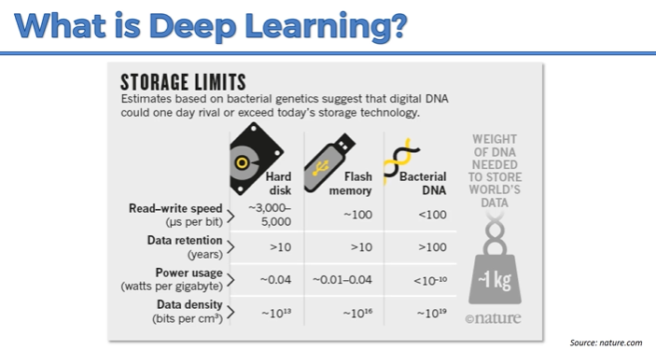
https://www.nature.com/news/how-dna-could-store-all-the-world-s-data-1.20496

Slide 7
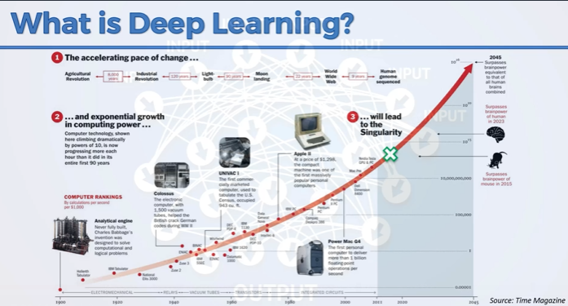

Slide 8
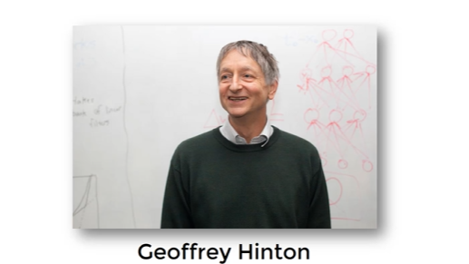
Deep Learning : The Godfather

Slide 9
Deep Learning
Deep Learning is a subfield of machine learning concerned with algorithms inspired by the structure and function of the brain called artificial neural networks.

Slide 10
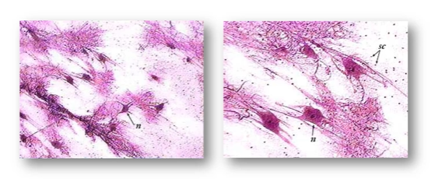
The Neuron
Artificial Neural Network : Intuition

Slide 11
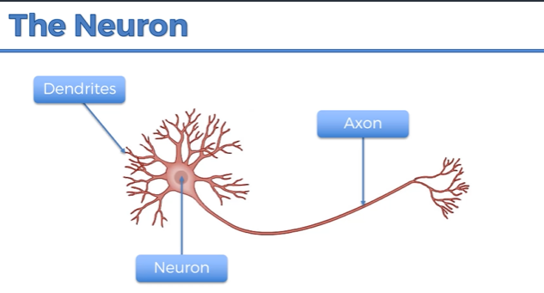

Slide 12
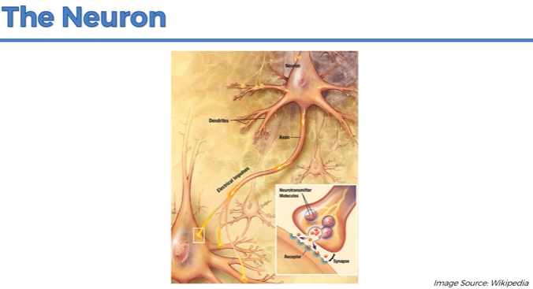

Slide 13
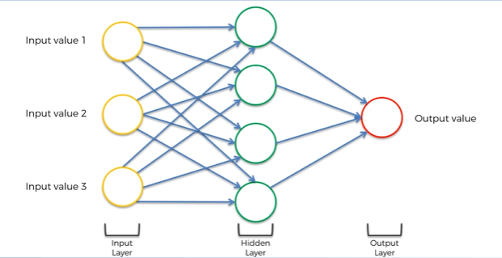
Artificial Neural Network : Intuition

Slide 14
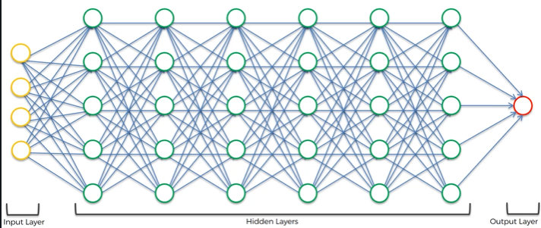
Artificial Neural Network : Intuition

Slide 15
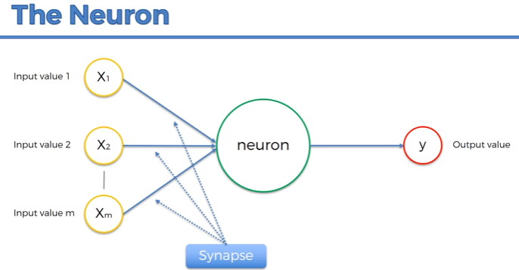

Slide 16
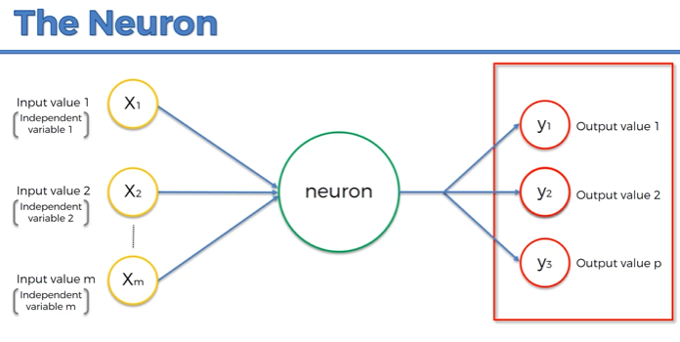

Slide 17
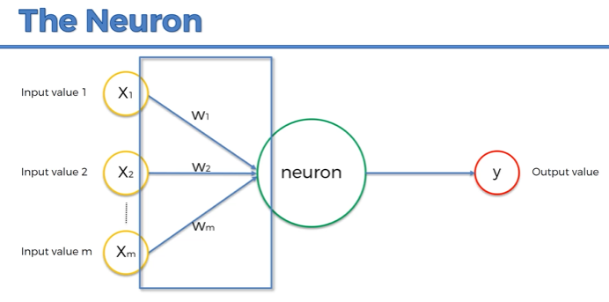
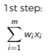

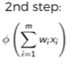
: Weights

Slide 18
The Activation Function
Threshold Function
Sigmoid Function
Rectifier Function
Hyperbolic Tangent Function

Slide 19
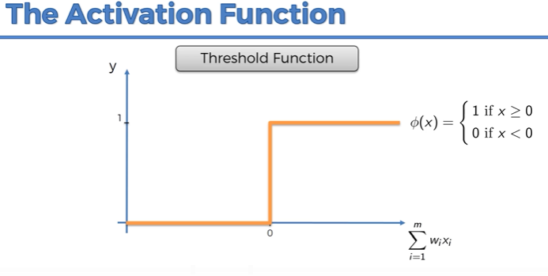

Slide 20
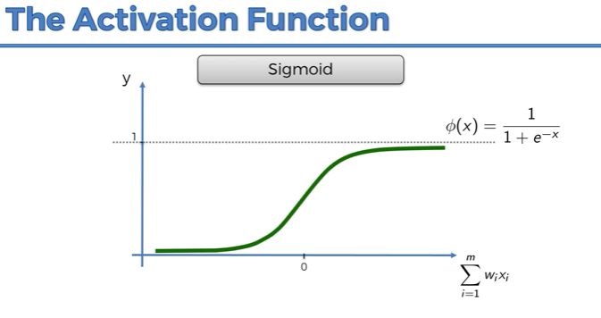

Slide 21
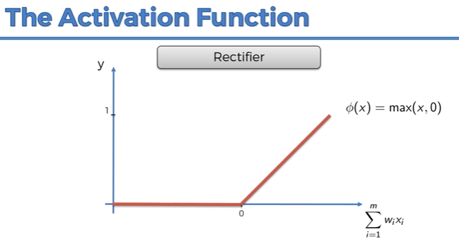

Slide 22
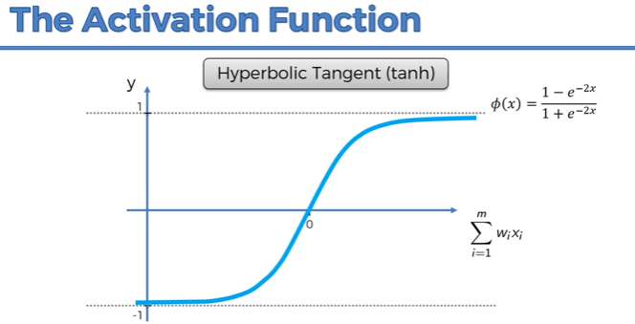

Slide 23
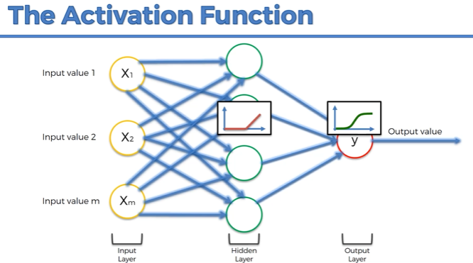

Slide 24
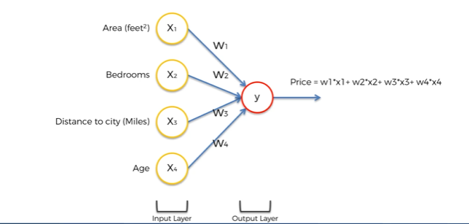
ANN : Working Problem Statement : Property Evaluation

Slide 25
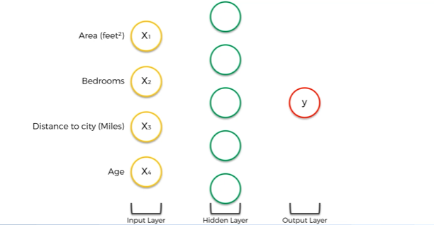
ANN : Hidden Layers

Slide 26
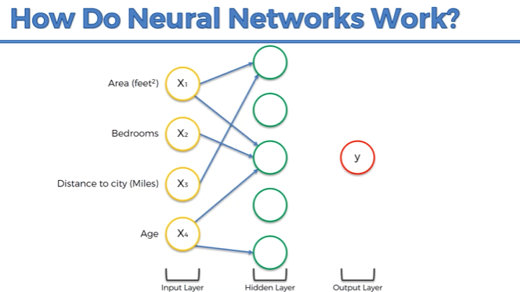

Slide 27
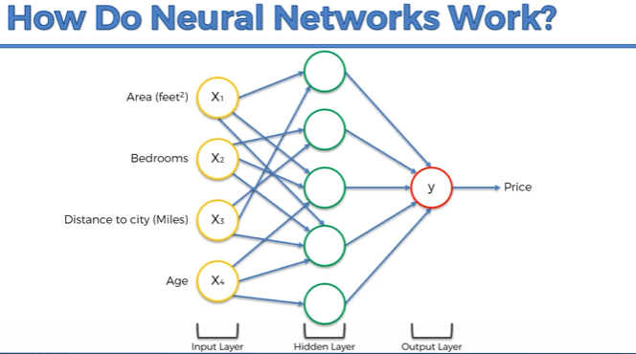

Slide 28
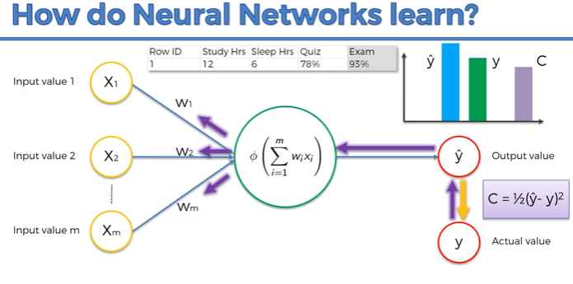


Slide 29
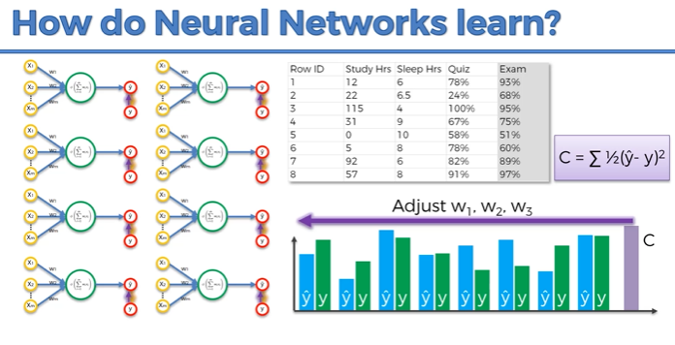

Slide 30
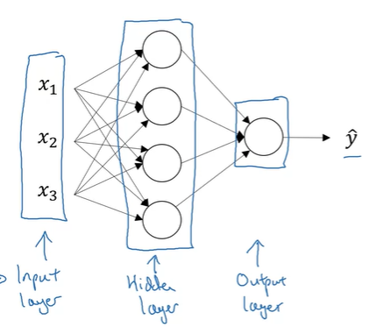
Two layered Neural Network: One hidden layer

Slide 31
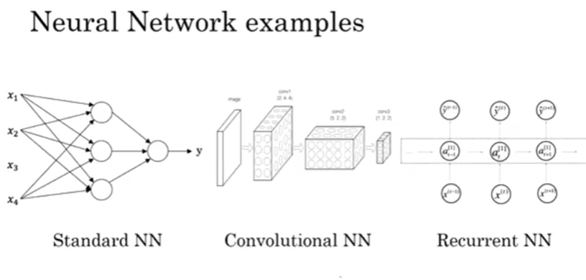

Slide 32
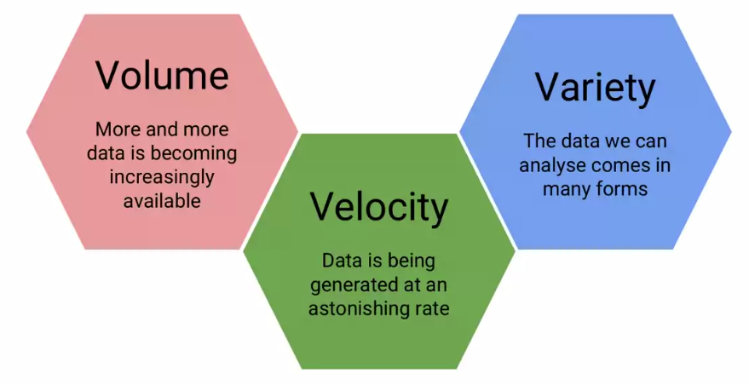
Big Data : Attributes

Slide 33
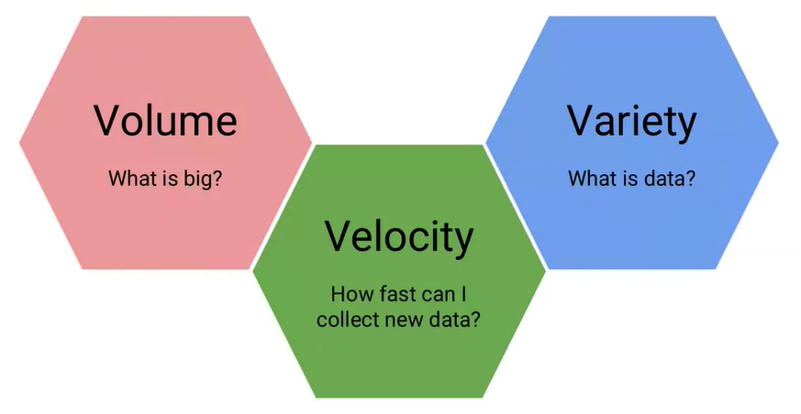

Slide 34
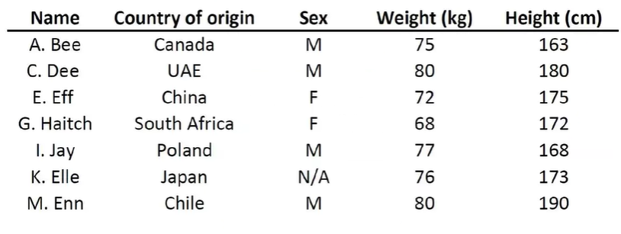
The structured data…

Slide 35
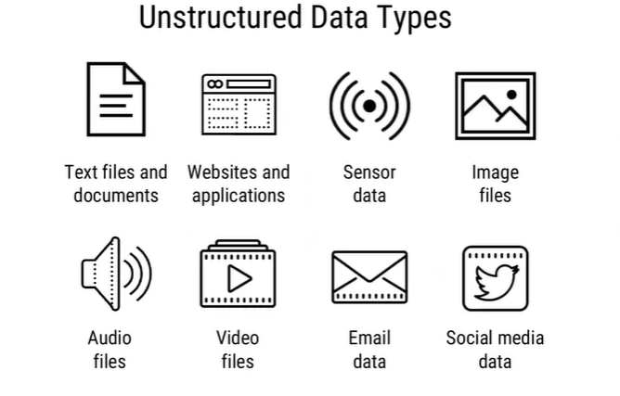
The unstructured data…

Slide 36
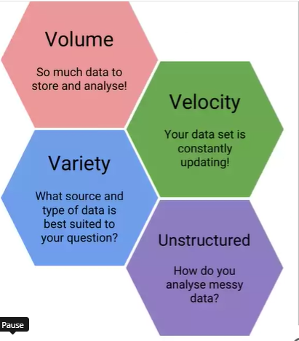
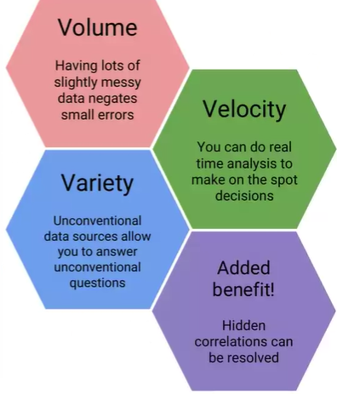

Slide 37
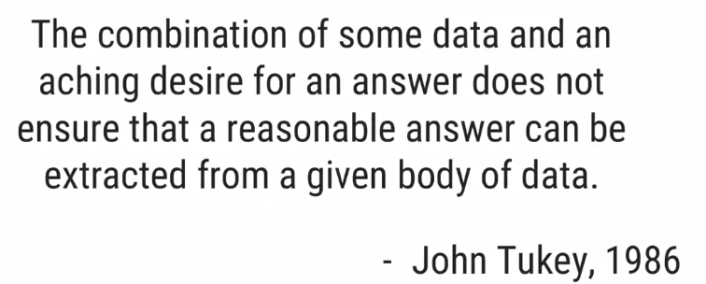

Slide 38
Thankyou ☺

Slide 39
Extra Slides

Slide 40
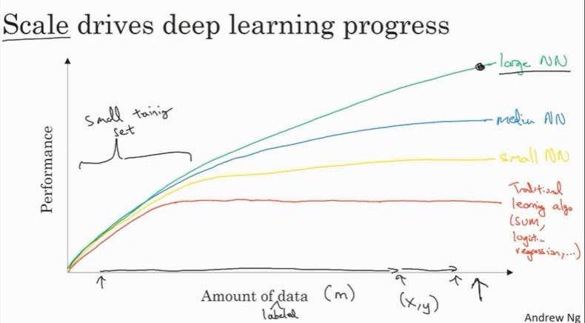
Why is DL becoming a hype after so long?

Slide 41
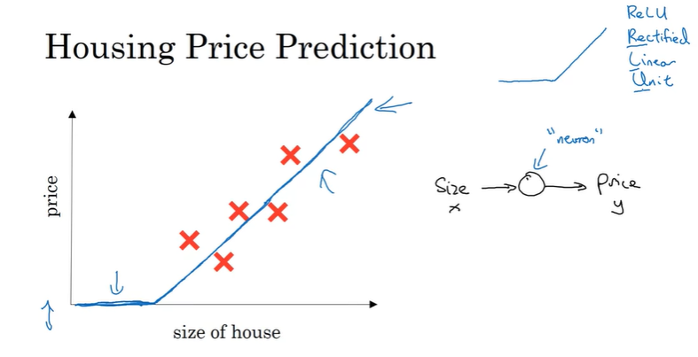
Deep Learning : Intuition

Slide 42
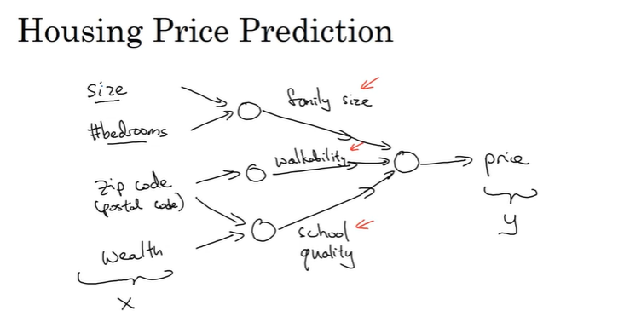
Deep Learning : Intuition (Contd..)

Slide 43
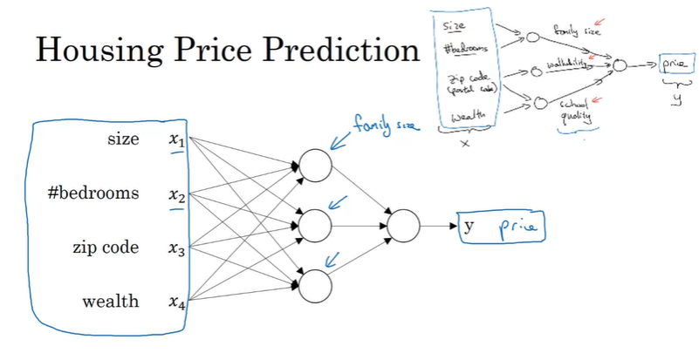
Deep Learning : Intuition (Contd..)

